Slide 1
ASCII Mandelbrot Sets

Slide 2

Notes:
A classic Mandelbrot set image

Slide 3
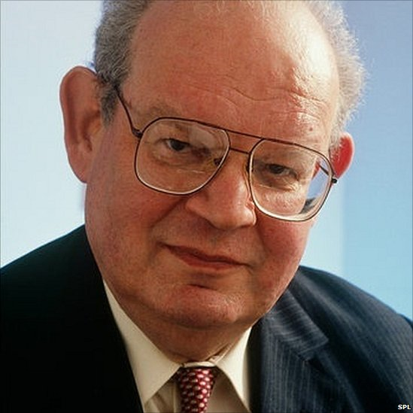
Benoît Mandelbrot (1924 – 2010)
Notes:
Discovered by Benoit Mandelbrot in 1979

Slide 4
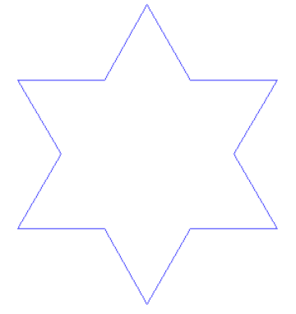
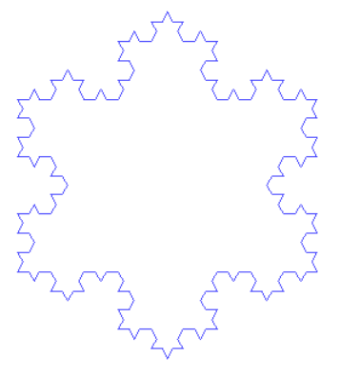
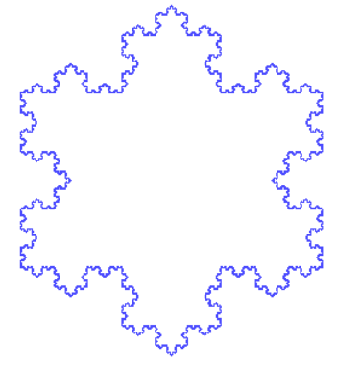
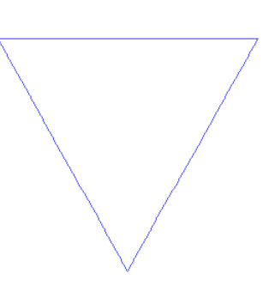
Geometric Fractals… The Von Koch Curve
Notes:
He was interested in fractals. This is an example fractal where you take each side of a triangle and add another triangle to it. The more you zoom in the more complex it becomes. The perimeter of the shape also increases to infinity. Another example is the length of the coast line of Britain. The more you zoom in, the better you measurements become, and so the length increases.

Slide 5
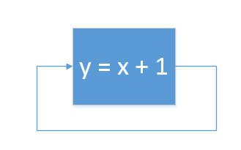

…and iterations
Notes:
Functions where you fed the result of a function back into itself.
The one we are interested is… where c is in the complex plane. We start with z0 = 0 and keep applying the function. Either the results will be unbounded and go off towards infinity or will give you a reoccurring sequence.
We say that these bounded values are in the Mandelbrot set, the ones which go off to infinite aren’t.

Slide 6
For each pixel (Px, Py) on the screen, do:
{
x0 = scaled x coordinate of pixel (scaled to lie in the Mandelbrot X scale (-2.5, 1))
y0 = scaled y coordinate of pixel (scaled to lie in the Mandelbrot Y scale (-1, 1))
x = 0.0
y = 0.0
iteration = 0
max_iteration = 1000
while ( x*x + y*y < 2*2 AND iteration < max_iteration )
{
xtemp = x*x - y*y + x0
y = 2*x*y + y0
x = xtemp
Iteration = iteration + 1
}
if iteration < max_iteration
plot(Px, Py, “ “)
else
plot(Px, Py, “@”)
}
Notes:
Fortunately, we can use this simple escape time algorithim from Wikipedia.

Slide 7
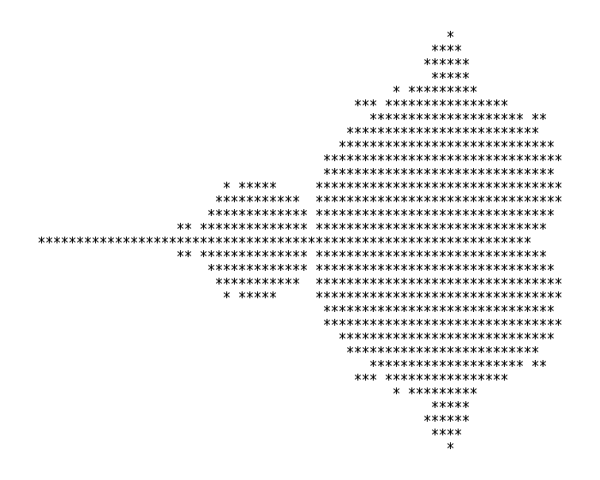
Notes:
To easily create an asci image

Slide 8
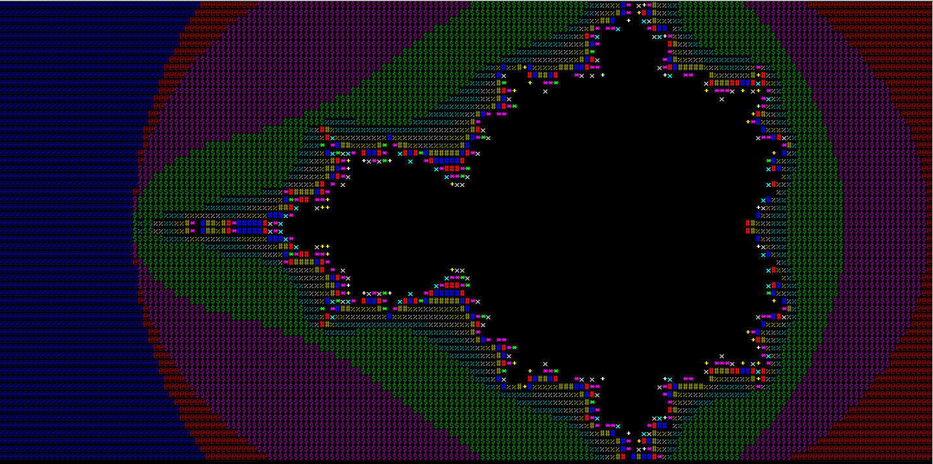

Slide 9
Further Ideas…
Using different symbols and/or colours based on the number of iterations
Ability to zoom in
Ability to spin the image around
Add a virtual tour around the interesting points
Implement using graphics instead of ASCII
Implement using a complex number type

Slide 10
Learn More….
https://www.youtube.com/watch?v=3yE4d7O17wE
https://en.wikipedia.org/wiki/Mandelbrot_set
http://mathworld.wolfram.com/MandelbrotSet.html

